Slide 1

Binary Search Trees: AVL Tree
Saif Hassan
Department of Computer Science
Sukkur IBA University
Data Structures
Data Structures and Algorithms

Slide 2
Learning Objectives
Understand what the height of a node is.
State the AVL property.

Slide 3
Agenda
Basic Idea
AVL Property

Slide 4
Balance
Want to maintain balance.
Need a way to measure balance.

Slide 5
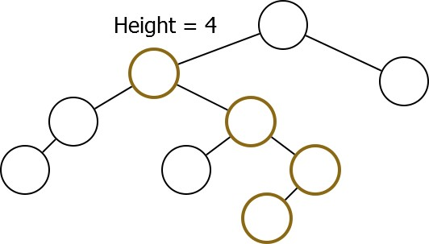
Height
Definition
The height of a node is the maximum depth of its subtree.

Slide 6
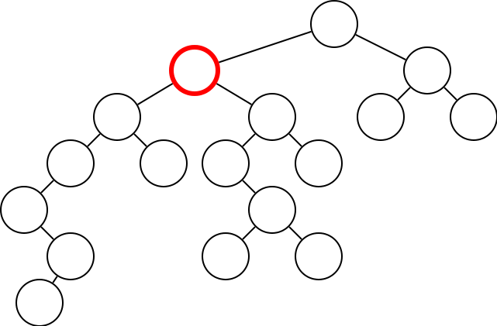
Problem
What is the height of the selected node?

Slide 7
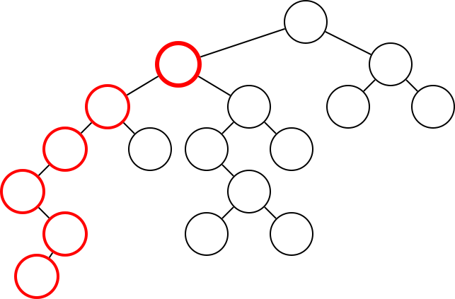
Problem
What is the height of the selected node?

Slide 8
Recursive Definition
if N is a leaf:
N.Height ← 1
otherwise
1 + max(N.Left.Height, N.Right.Height)

Slide 9
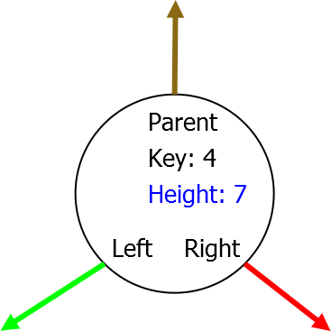
Field
Add height field to nodes.

Slide 10
Field
Add height field to nodes.
(Note: We’ll have to work to ensure that this is kept up to date)

Slide 11
Balance
Height is a rough measure of subtree size.
Want size of subtrees roughly the same. Force heights to be roughly the same.

Slide 12
Agenda
Basic Idea
AVL Property

Slide 13
AVL Property
AVL trees maintain the following property: For all nodes N ,
|N.Left.Height − N.Right.Height| ≤ 1 We claim that this ensures balance.

Slide 14
Conclusion
AVL Property
If you can maintain the AVL property, you can perform operations in O(log(n)) time.

